Slide 1
Virtualization

Slide 2
5.1 Virtual Machines
Running One application on one server is wastage of money i.e. DB server, email, Web server
A virtual machine takes the layered approach to its logical next step. It treats hardware and the operating system kernel as though they were all hardware
A virtual machine provides an interface identical to the underlying bare hardware
The operating system host creates the illusion that a process has its own processor (and virtual memory)
Each guest provided with a (virtual) copy of underlying computer

Slide 3
Virtual Machines (Cont.)

Slide 4
Hypervisor / VMM

Slide 5
Types of Hypervisors
(a) A type 1 hypervisor (b) A type 2 hypervisor

Slide 6
Types of Hypervisors
(a) A type 1 hypervisor (b) A type 2 hypervisor

Slide 7
5.2 Containers
VMs consume a lot of disk space, RAM and CPU due to its own OS, slow to startup
Containers only contains applications
A Container is an application that’s been packaged with all the files, configurations, dependencies necessary for its run
The leading software that is used to create, manage and run containers is dockers
Containers are considered as light-weight (small app size), fast bootup, less recourses consumption, portable files
Drawback: Containers applications are totally depending upon the underlying OS, less secure

Slide 8
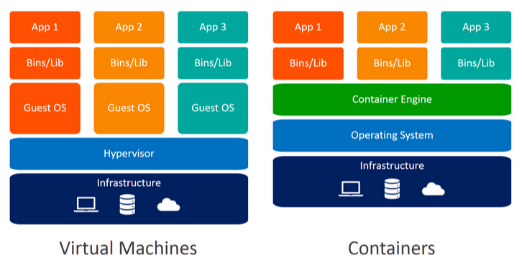
Virtual Machines vs. Containers

Slide 9
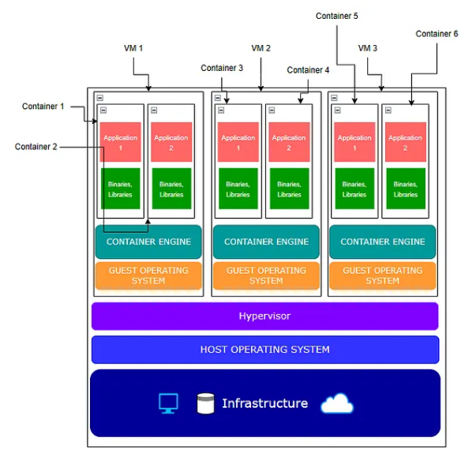
Hybrid Use

